Slide 1
Applied Data Science Masters Portfolio
Spring 2020
Eric W Rodgers
Syracuse University

Slide 2
Table of Contents
Introduction
Reflection
  Strengths
  Weaknesses (Opportunities to Improve)
Information Gained
  Collect & Organize Data
  Pattern Identification
  Business Decision Implementation
  Communication
Thank you!

Slide 3

Introduction
Professional
13 years of Project Management experience in the oil and gas industry
Currently work for TC Energy as a Project Scheduling Manager
Worked across multi-billion-dollar construction projects around the world (Indonesia, China, Malaysia and Singapore)
Never held a programming position although have worked with large data sets in current and previous roles
Educational
Studied GIS @ Sam Houston State University (Graduated in 2007)
Speak Indonesian and Chinese
Notes:
Scheduling – Telling the Future based on current conditions

Slide 4
Reflection
Strengths
  The Case for Clean Data
  Prediction Methods (Models)
  Data Storage
  Reporting & Visualizations
Weaknesses (Opportunities to Grow)
  Statistical Aspirations?
  Python

Slide 5
Knowledge Gained
Collect and Organize Data
  Collecting
  Cleaning
  Output
Pattern Identification
  Statistical Analysis
  Data Mining
  Visualizations
Business Decision Implementation
  Real World Applications
Communication
  Communicating to Tech folks
  Speaking with the outside world

Slide 6
Project 1: Coaches Salary
(Collection of Data, Pattern Identification, Business Decision Implementation)
Project 2: Yelp Sentiment (Collection of Data, Pattern Identification, Business Decision Implementation)
Project 3: Marketing Research (Pattern Identification, Business Decision Implementation)
Project 4: Kickstarter (Pattern Identification, Business Decision Implementation)
Projects

Slide 7
Coach Salary Prediction
Football Coach Salary Data for NCAA Universities (Base Data) - 129 Rows
Collected Data
  Football Coaches Background
  School GSR / FSR Rates
  Endowment Amounts
  Stadium Capacity
  Overall Winning Percentage of Previous Season
Overall Goal – To collect, clean, combine, visualize (understand the data) and predict the football coaches' salary (linear regression).

Slide 8
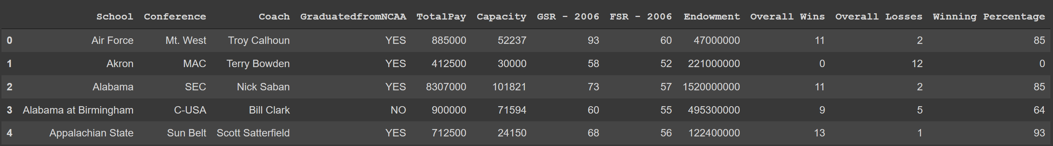
Importing & Cleaning
Import in Base Data (Manual addition of 1 column)
Clean out unnecessary columns
Normalize Names across data sets
Merge External Data on School
Delete NAN columns
Change all numbers to integers (no $)
School | Endowment | Total Pay
Navy | NO | YES
Army | NO | YES
Georgia State | NO | YES
Baylor | YES | NO
Brigham Young | YES | NO
Rice | YES | NO
Southern Methodist | YES | NO

Slide 9
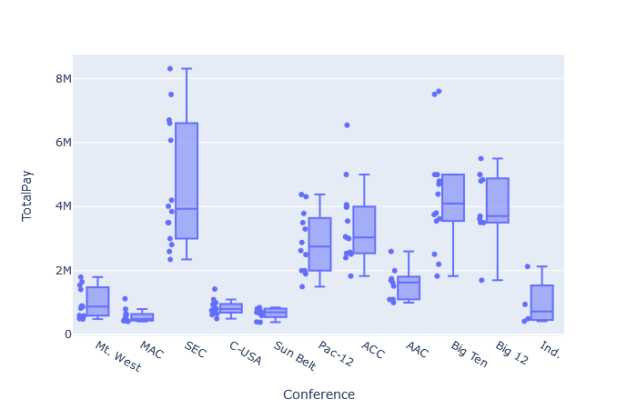
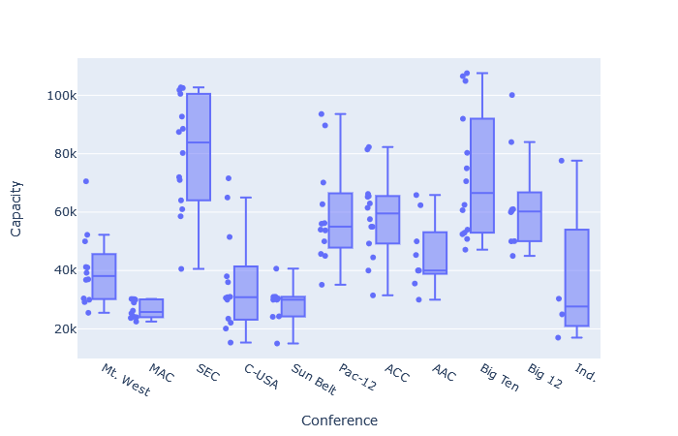
Pattern Identification & Visualizations

Slide 10
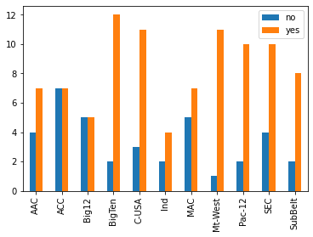
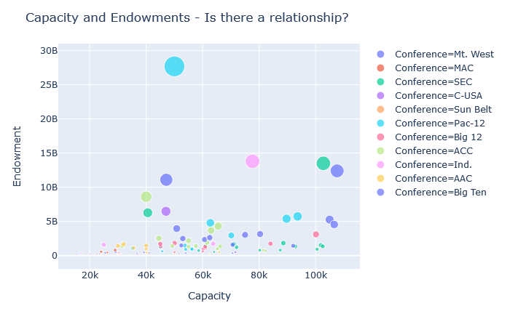
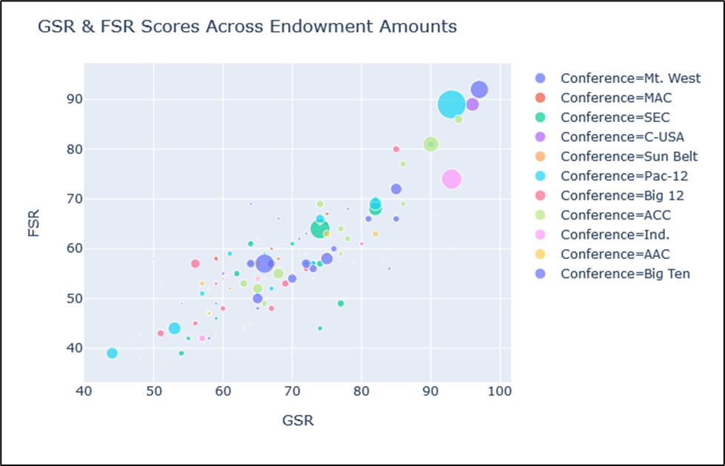
Pattern Identification & Visualizations

Slide 11
Model & Findings / Business Decision Implementation
Bigger Conferences Pay More and generally have more seating
Conference has the biggest coefficient weightage
Most Coaches graduated from NCAA Schools
The higher the scores (GSR/FSR) the more endowment
Model 1 (Predicted on Only Conference)
  68% Adjusted R2
Model 2 (Predicted on Conference & Endowment)
  71% Adjusted R2 , Endowment significant
Model 3 (Predicted on Conference, Coach Graduated from NCAA School)
  68% Adjusted R2, Coach Graduated from NCAA School, significant
Model 4 (Predicted on Conference & Capacity)
  75% Adjusted R2, Capacity not significant
Model 5 (Predicted on Conference, GSR/FSR Scores)
  70% Adjusted R2, GSR Not significant, FSR significant

Slide 12
Yelp Sentiment
Yelp Restaurant Review Data
Collected Data
  74 restaurants total restaurants
  50 Reviews per restaurant
  Analysis seeks to see the difference between cheap and expensive restaurants
Overall Goal – To Scrape, vectorize, visualize and find out what people are saying in different types of restaurant across the cheapest and most expensive places to eat. Model and predict based on sentiment.

Slide 13
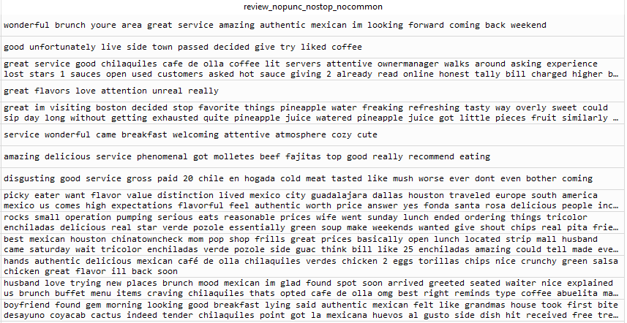
Importing & Cleaning
Lower all words, remove all Stop Words and Custom Stop Words
Vectorize the data (count / tdidf)
Initial Word Clouds built for quick analysis of reviews

Slide 14
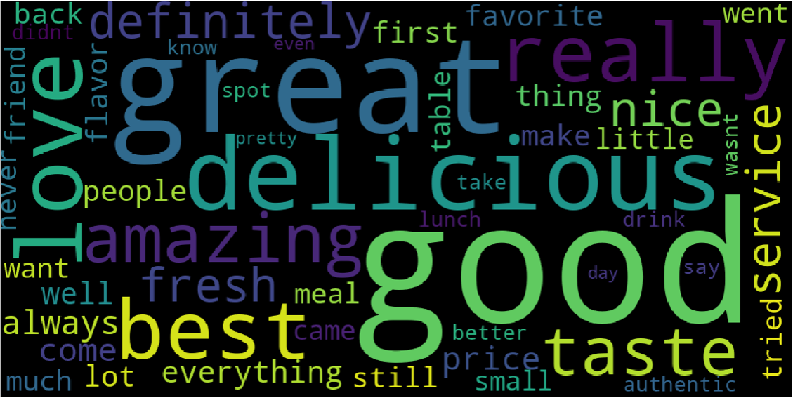
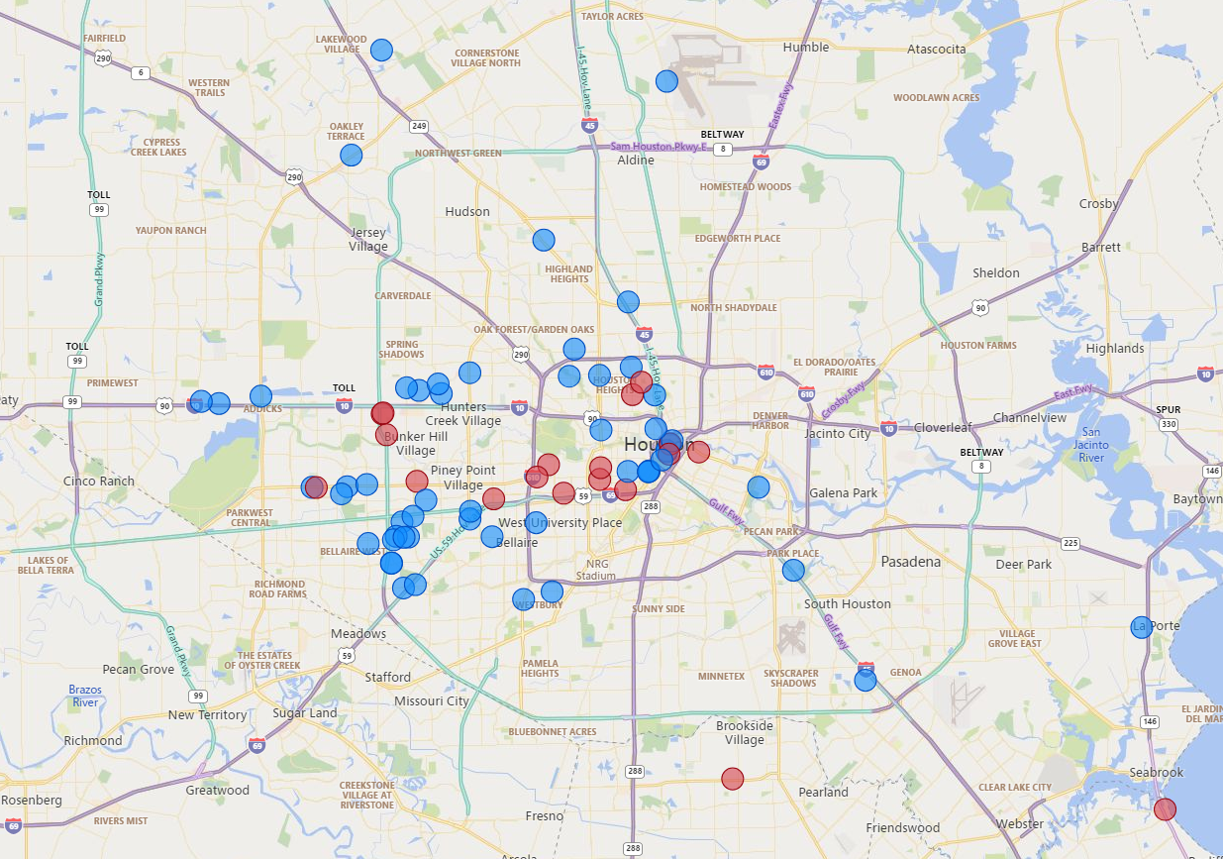
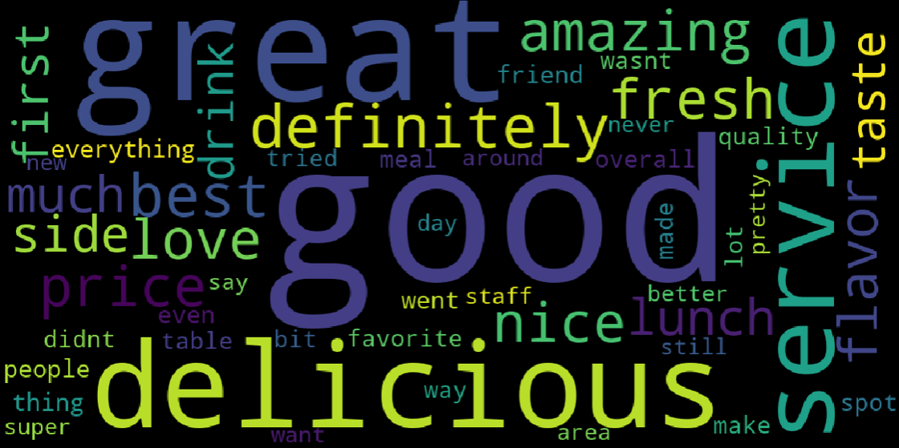
Pattern Identification & Visualizations
Cheap
Expensive

Slide 15
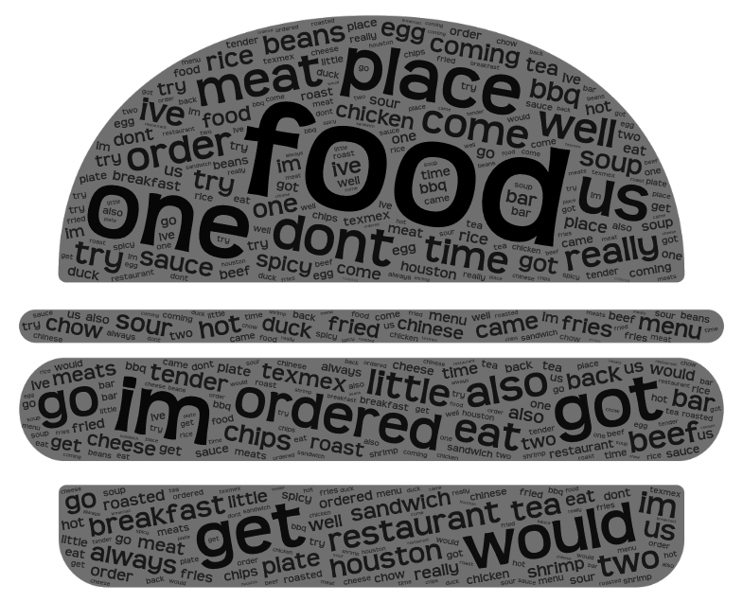
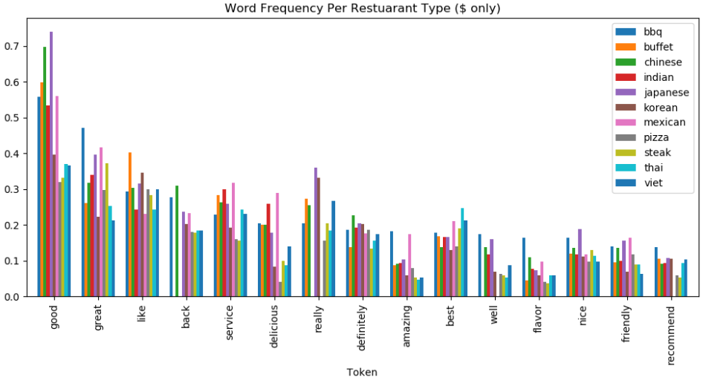
Pattern Identification & Visualizations
60 Custom Stop Words
Word Frequencies for all Restaurant Types

Slide 16

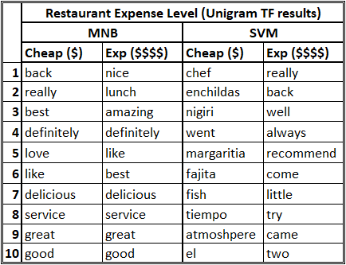
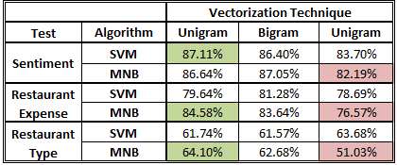
Model & Findings / Business Decision Implementation
Unigram Term Frequency Vectorizer gave best results
Bigram only helped marginally on 2 out of 6 models
SVM and Multinomial Naïve Bayes no clear winner for prediction
Baseline Accuracy
Top Word Features
between $ and $$$$
Method Accuracies
The skew in the restaurant expense type is due to the prevalence of cheaper restaurants compared to the high-end establishments that are more sporadic.

Slide 17
Airline Satisfaction
Kaggle Dataset (2019) for Customer Satisfaction
Collected Data
  Customer Satisfaction (0 or 1)
  Class of Customers
  Precheck Ratings of Services (Ease of online booking, online boarding, etc.)
  Inflight Ratings of Services (In-flight entertainment, food, etc.)
  Whether a customer was considered loyal or disloyal to the airline
Overall Goal – To clean and visualize the data to find out how or what does a customer consider when they say they are satisfied. Predict by decision tree and logistic regression the likelihood of a satisfied customer with different survey parameters. Also highlight the most important features of loyalty and satisfaction.
Notes:
https://www.kaggle.com/teejmahal20/airline-passenger-satisfaction/data

Slide 18
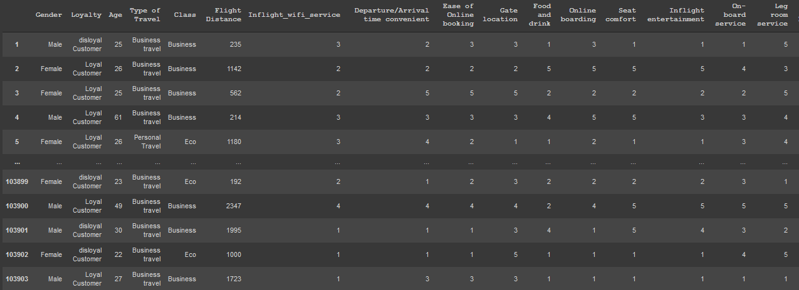
Importing and Cleaning
Removed Children from Survey Data (Age Column)
For Certain Models, made Survey data into Dummy Variables (limitation of scikit learn)
Reamed Customer Type to Loyalty
Removed Wi-Fi survey score of 0 (not applicable status)

Slide 19
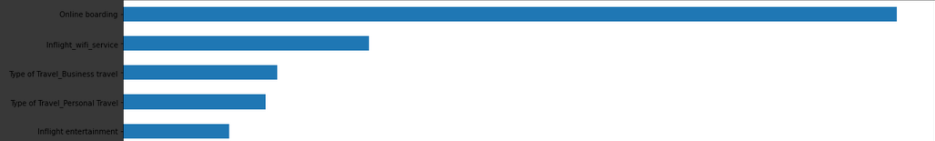
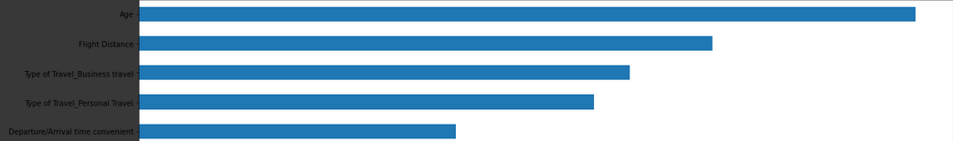
Pattern Identification & Visualizations
Random Forest Most Import Features – 500 trees
SATISFACTION
Random Forest Most Import Features – 500 trees
LOYALTY

Slide 20
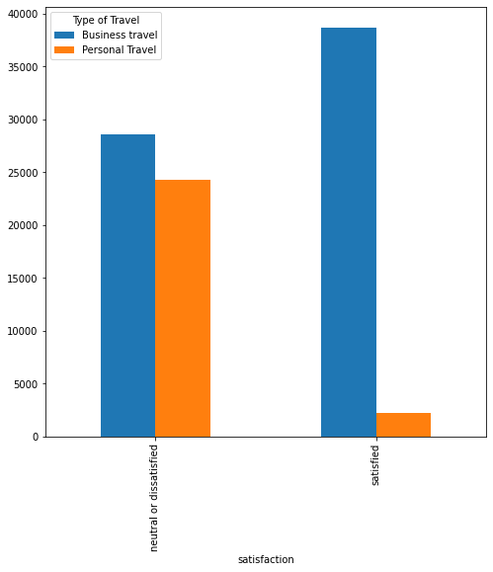
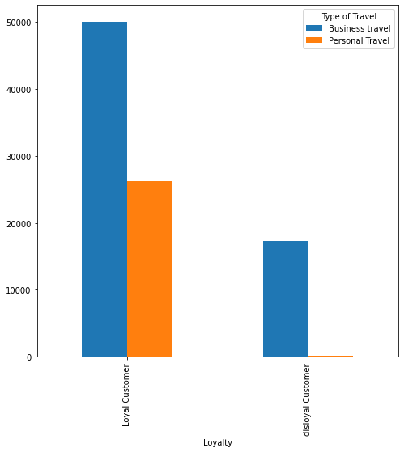
Pattern Identification & Visualizations

Slide 21
Model & Findings / Business Decision Implementation
 | (y) prediction variable | Method | Most Important Features | Prediction Accuracy (Test Size = 0.33)
Test 1 | Loyalty | Dummy Variables for all survey data and Gender, Class, Customer Type | Age, Flight Distance, Personal Travel, Business Travel, Baggage Handling(5) Satisfaction #10 | 92%
Test 2 | Satisfaction |  | Class(Business), Inflight wifi Service(4)(5), Online boarding(4)(5) Loyalty #10 | 89%
Test 3 | Loyalty | Dummy Variables for only Gender, Class, Customer Type | Age, Flight Distance, Business Travel, Personal Travel, Departure/Arrival time convenient Satisfaction #15 | 92%
Test 4 | Satisfaction |  | Online boarding, Inflight wifi service, Personal travel, Business Travel, Inflight entertainment Loyalty #7 | 88%

Slide 22
Kickstarter
Kaggle Dataset (2019) for Customer Satisfaction
Collected Data
  Project Category
  Currency + Goal Amount
  Pledged Amount
  State of Project (failed, successful, cancelled, live, etc.)
  Country of Origin
Overall Goal – To clean and visualize the data to find out what are some of the factors that contribute to the success or failure of a Kickstarter Campaign.
Notes:
https://www.kaggle.com/teejmahal20/airline-passenger-satisfaction/data

Slide 23
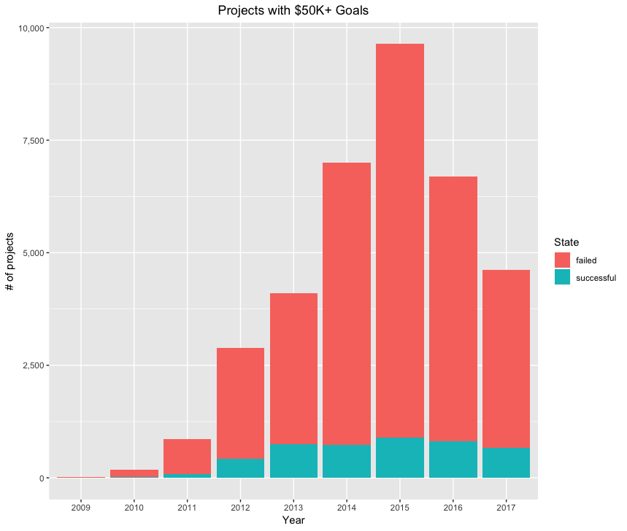
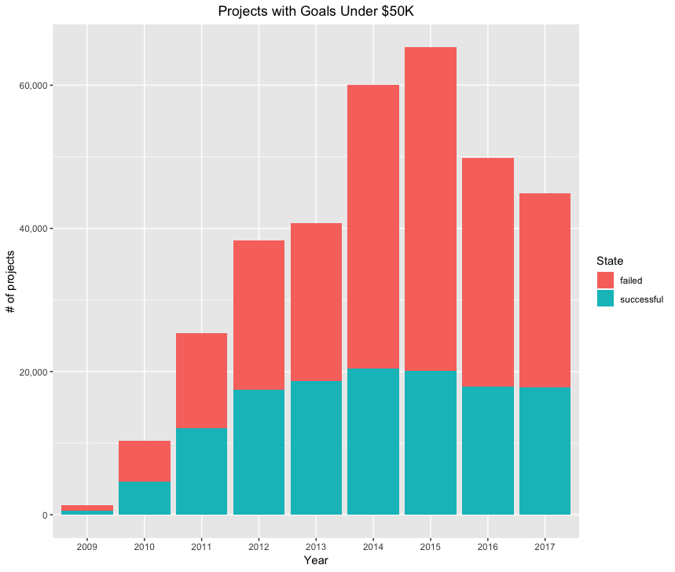
Pattern Identification & Visualizations

Slide 24
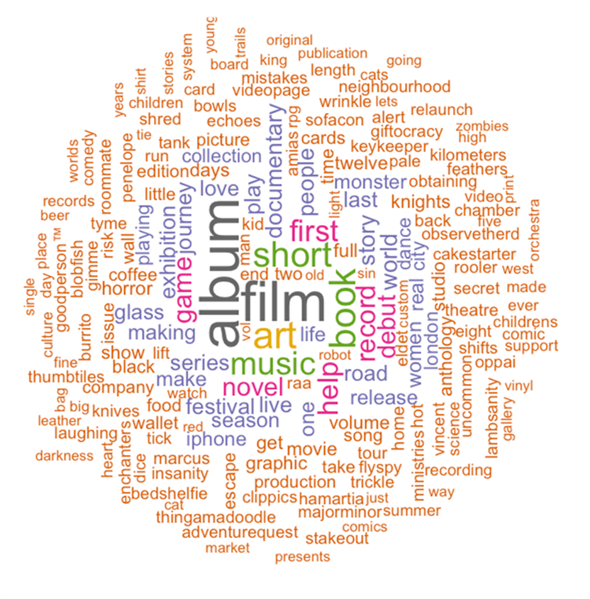
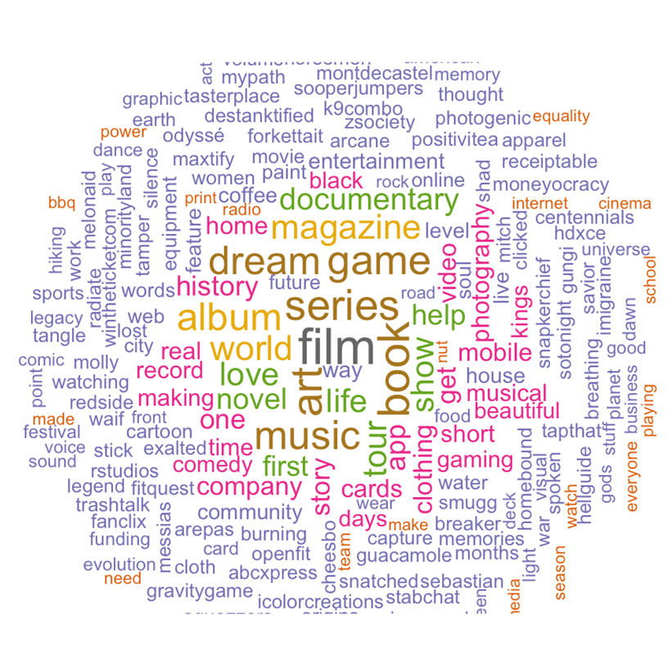
Pattern Identification & Visualizations
Successful
Album
Film
Book
Music
Novel
Short
Record
Debut
Unsuccessful
Film
Series
Dream
Game
World
Magazine
Documentary
History

Slide 25
Pattern Identification & Visualizations
Association Rule Mining!
Rule | State | Support | Confidence | Lift
Technology | Failure | 0.06 | 90% | 1.2
Film & Video + $50K+ goal | Failure | 0.015 | 89% | 1.4
Publishing + 100+ backers | Success | 0.011 | 93% | 2.58
Music + 50+ backers | Success | 0.018 | 92% | 2.55

Slide 26
Business Decision Implementation
Kickstarter Campaigns (Western Countries tend to be more open to new and clever ways to get products out to people)
Keep Goals within reach to grab as many funders as possible
Avoid certain categories with high cost and low success, i.e. technology & fashion
Model Findings
 | Accuracy | Most Important Features
Decision Tree | 91.02% | Backers, Goal
Random Forest | 92.69% | Backers, Goal, Category
kNN | 90.57% | Country, Goal, Backers, Category, Days

Slide 27
Print(“Thank you Syracuse”)
Thank you to all the Syracuse University Staff!
Special Thanks to
Professor Fox…..thank you for pushing me to my limits!
Professor Gates….thank you for always giving it to us straight.
Professor Bolton….thank you for the stretches during class and the awesome Text Mining class.
Ellen Petley…. thank you for checking up on me through the semester!
John Ofrecio….thank your for introducing me into the Syracuse family.

